Slide 1



CyberPedia
Alerting today for better tomorrow
-BY TEAM DIRECTRIX

Slide 2


MEET OUR TEAM
DANISH ALI (TEAM LEADER)
NANDAN PATKAR
aashi shukla
palak jaiswal
abhishek manglani
ANUSHA SATSANGI
ANUJ KHATRI

Slide 3






Problem statement
WHATEVER INFORMATION OR PERSONAL DETAILS ARE SHARED ON THE INTERNET STAY ONLINE FOREVER AS IT IS EXTREMELY DIFFICULT TO DELETE THE INFORMATION COMPLETELY
ANYONE WHO USES A COMPUTER CONNECTED TO THE INTERNET IS SUSCEPTIBLE TO THE
THREATS THAT COMPUTER HACKERS AND ONLINE PREDATORS POSE !!
EMAIL
SPOOFING
BANKING
FRAUD
IDENTITY
THEFT
CYBER
BULLYING
DATA
BREACH
EMAIL SPOOFING

Slide 4


WHAT ARE THE MAJOR
PROBLEMS?
CYBER CRIMES IN INDIA
SOCIAL MEDIA THREATS
LOSSES DUE TO CYBER ATTACKS
Impersonation
21.8%
2,000,000
Social media
1,500,000
Fraud
45.6%
Credit card
1,000,000
Cyber Threat
19.4%
Banking
500,000
0
Data Leak
13.2%
other
2014
2015
2016
2017
2018
2019
2020
2021
2022
SHARP INCREASE OF CYBER CRIMES IN INDIA
0 Billion
25 Billion
50 Billion
75 Billion
100 Billion

Slide 5
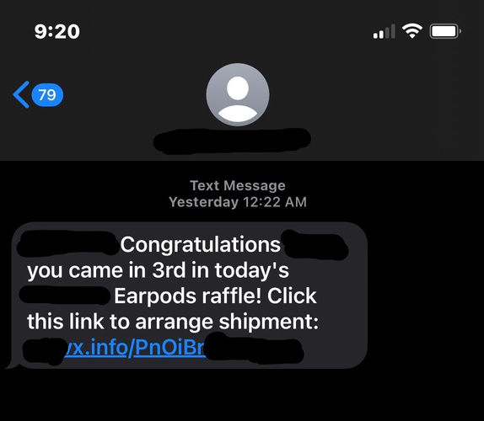
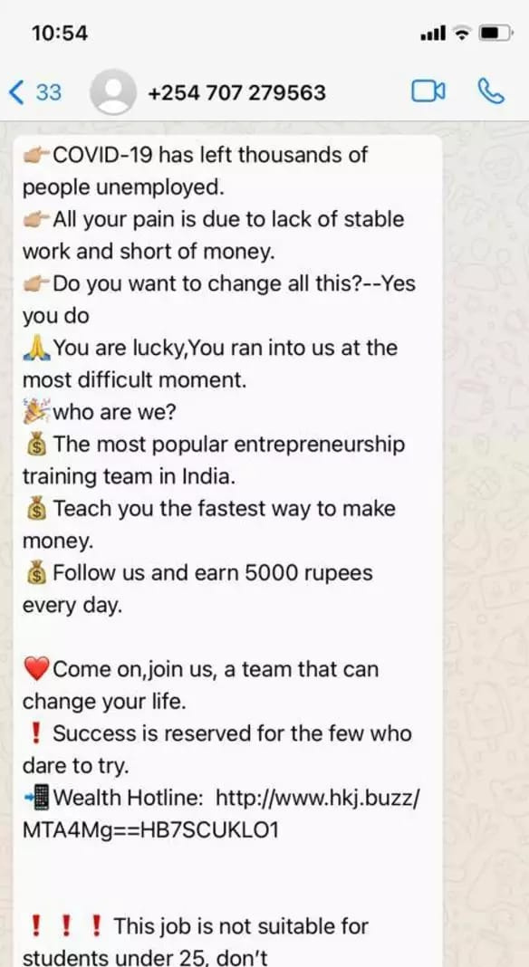

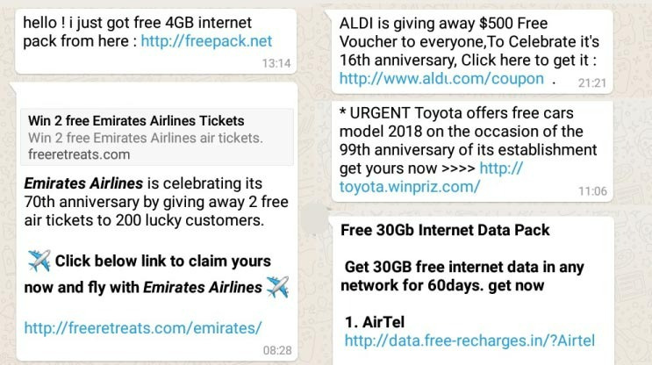
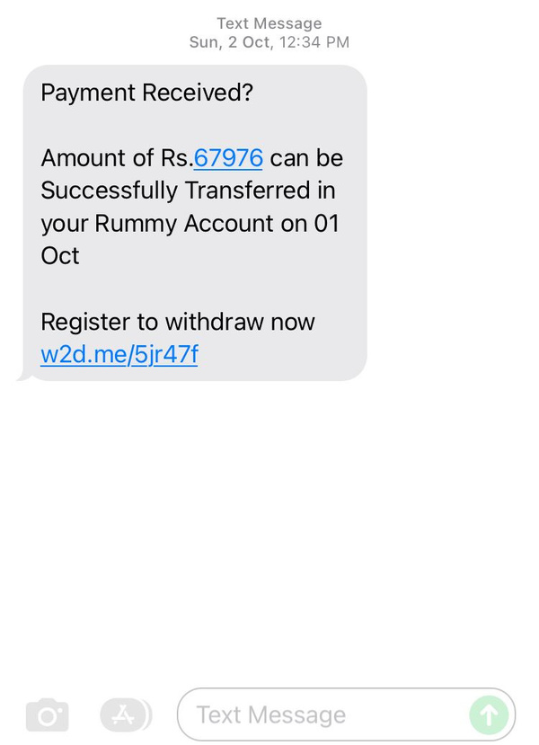
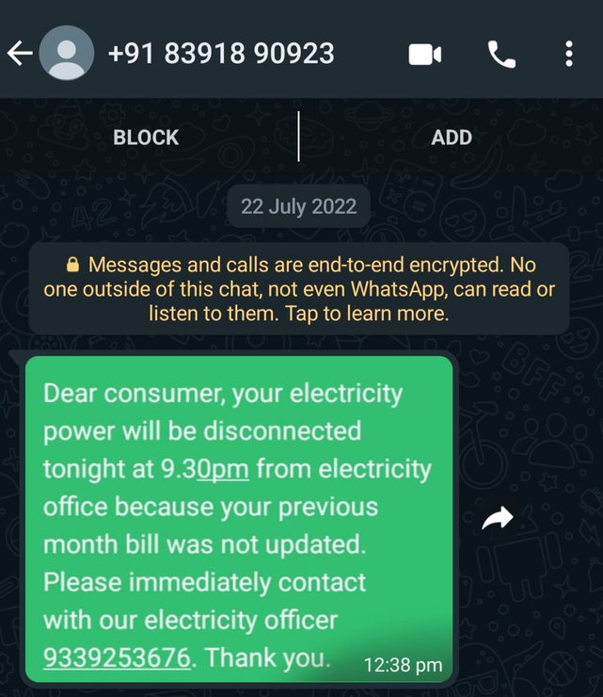
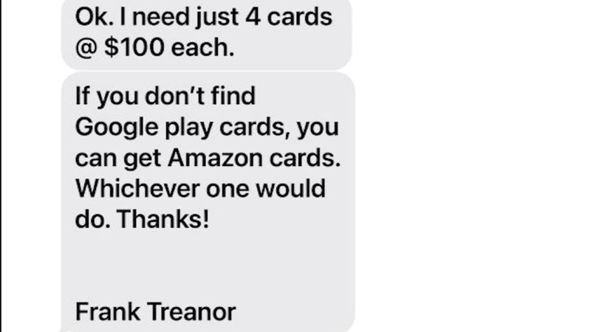
Scammers Around Us!

Slide 6
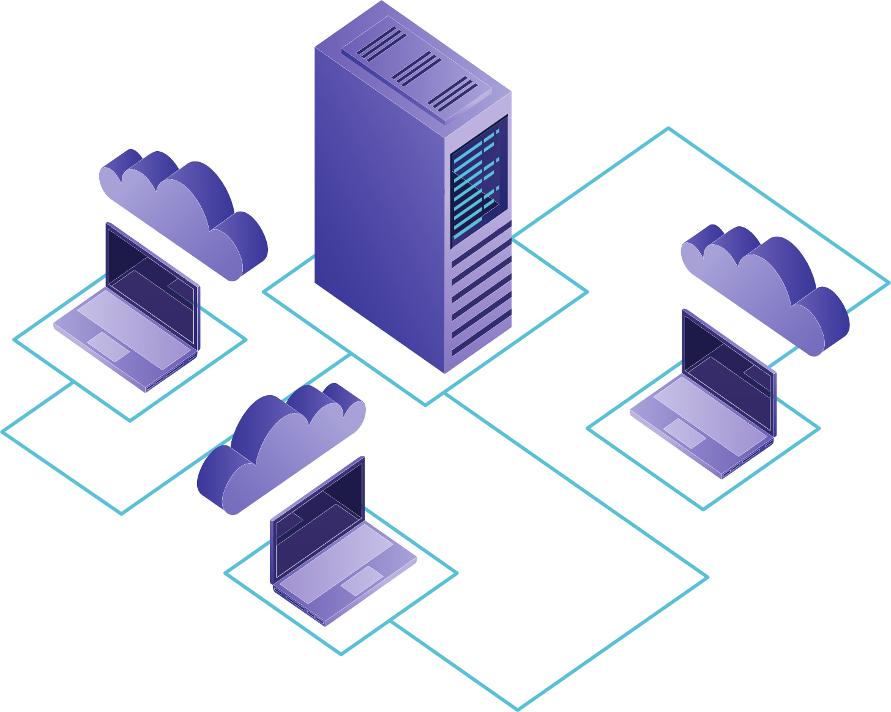
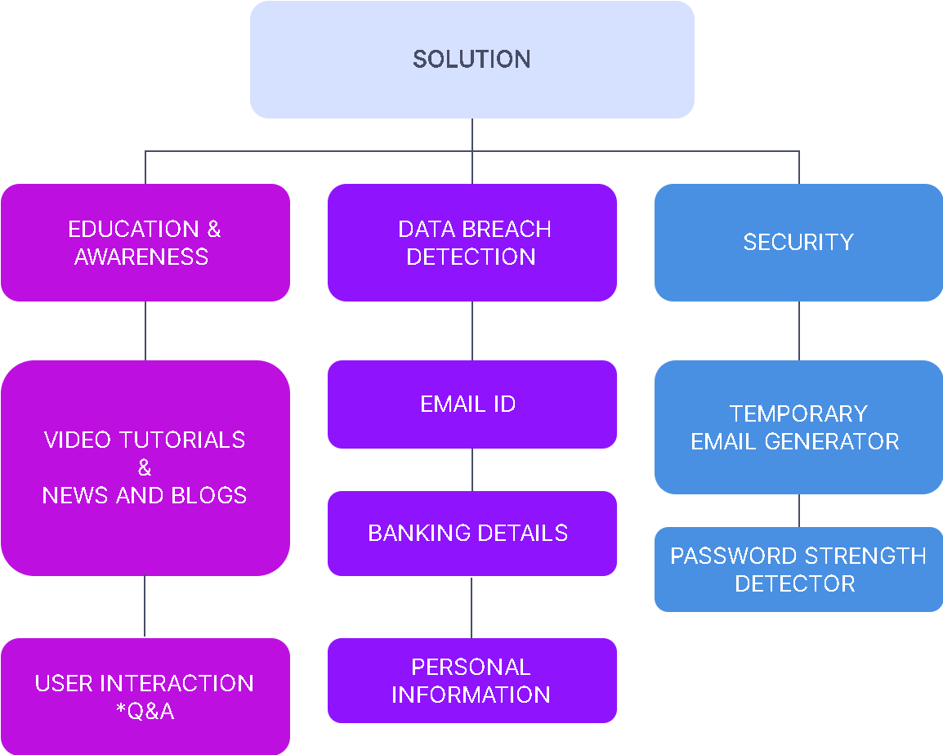




Our Solution :

Slide 7





VIDEO TUTORIALS
CYBER SAFETY
TIPS AND TRICKS
The video tutorials will aim at how we should use our network space so that there is no harm to data loss.
Video tutorials are going to be short and easy to understand.
The tutorials will be made user interactive by putting a quiz at the end of the tutorial to make user understand how much they had learned from our tutorials.

Slide 8
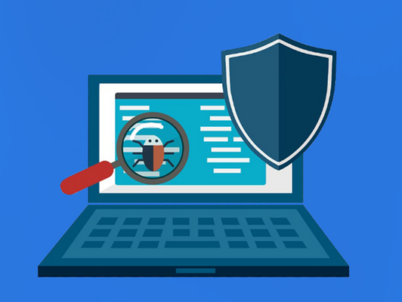

Data Breach Finder :
In our Platform, We will Anonymously search across multiple data breaches to see if your email address, DOB and sensitive data that has been exposed and what actions you should take as a result.
News & Blogs :
Our website will contain various news, blogs and articles related to cyber security and we would also update our website with news on various cyber crimes that are happening all over the world.

Slide 9


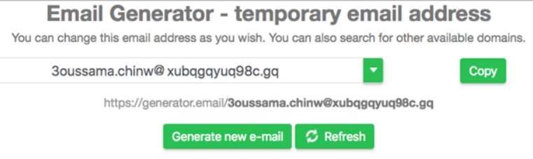


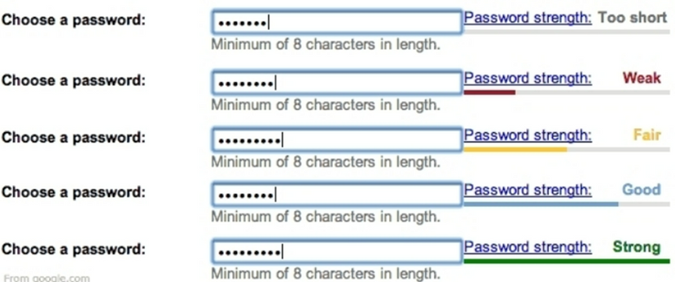

Temporary E-mail Generator:
Disposable email address (DEA) technically means an approach where a user’s with a unique email address gets a temporary email address for your current contact. The DEA allow the creation of an email address that passes validity need to sign-up for services and website without having to show your true identity.
Password Strength Checker:
Check how strong and secure is your pasword. Improve the strength of your password to stay safe.
We would also provide an option in our website through which one can check the strength of their password,alter them according to the suggestions suggested by the website.

Slide 10

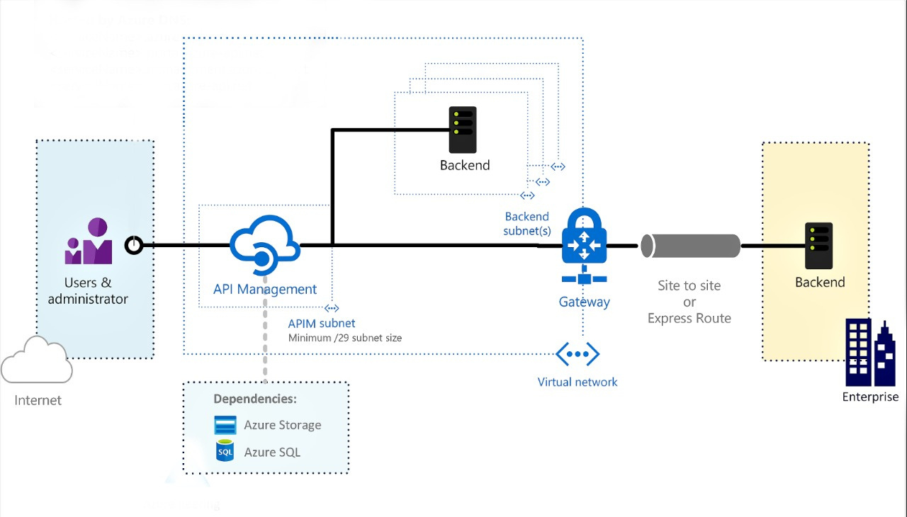
Idea Approach

Slide 11
Business model
Market overview :
2,500,000
The cybersecurity market in India is expected to grow from $1.97 billion in 2019 to $3.05 billion by 2022, at a compound annual growth rate (CAGR) of 15.3%, according to a joint study by PwC India and DSCI. The study also stated that banking, financial services and insurance (BFSI), IT, and government are the top three sectors with the largest market share in cyber security expenditure in the country. This pre-COVID assessment may actually underestimate the growth of the cybersecurity market, if the digital economy booms in the post-COVID-19 era.
2,000,000
1,500,000
1,000,000
500,000
0
2018
2019
2020
2021
2022(EST)

Slide 12


Marketing Strategy
Promoting affiliate marketing
It is going to help us to create a traffic on our webpage and connecting more and more companies via affiliate marketing , for example we all think google is a search engine but it Is also a biggest affiliate marketing source
Network marketing
Network marketing is the perfect method through we can generate revenue at zero capital but time and therefore it is a best example of “Time is leverage”.
And according to stats of network marketing in India :
The research shows very promising results in growth as well as generating revenue .

